Slide 1
ISOMORPHISM AND SUBGRAPHS
NAME:G.SOWMYA
ROLL NO:22H51A0588

Slide 2
Table of contents
01
02
03
04
INTRODUCTION
ISOMORPHISM
SUBGRAPHS
CONCLUSION

Slide 3
01
INTRODUCTION

Slide 4
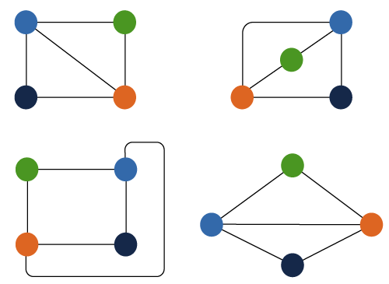
Introduction
The isomorphism graph can be described as a graph in which a single graph can have more than one form. That means two different graphs can have the same number of edges, vertices, and same edges connectivity. These types of graphs are known as isomorphism graphs.

Slide 5
02
ISOMORPHISM

Slide 6
ISOMORPHISM
Conditions for graph isomorphism:
Any two graphs will be known as isomorphism if they satisfy the following four conditions:
There will be an equal number of vertices in the given graphs.
There will be an equal number of edges in the given graphs.
There will be an equal amount of degree sequence in the given graphs.
If the first graph is forming a cycle of length k with the help of vertices {v1, v2, v3, …. vk}, then another graph must also form the same cycle of the same length k with the help of vertices {v1, v2, v3, …. vk}.

Slide 7
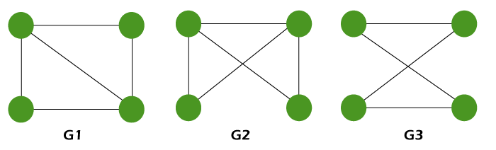
ISOMORPHISM
EXAMPLE:
Check whether the following graphs are isomorphism.
Condition 1:
In graph 1, there is a total 4 number of vertices, i.e., G1 = 4.
In graph 2, there is a total 4 number of vertices, i.e., G2 = 4.
In graph 3, there is a total 4 number of vertices, i.e., G3 = 4.

Slide 8
ISOMORPHISM
Condition 2:
In graph 1, there is a total 5 number of edges, i.e., G1 = 5.
In graph 2, there is a total 5 number of edges, i.e., G2 = 5.
In graph 3, there is a total 4 number of edges, i.e., G2 = 4.
Condition 3:
In the graph 1, the degree of sequence s is {2, 2, 3, 3}, i.e., G1 = {2, 2, 3, 3}.
In the graph 2, the degree of sequence s is {2, 2, 3, 3}, i.e., G2 = {2, 2, 3, 3}.
Condition 4:
Graph G1 forms a cycle of length 3 with the help of vertices {2, 3, 3}.
Graph G2 also forms a cycle of length 3 with the help of vertices {2, 3, 3}.
Thus,
The graphs G1 and G2 satisfy all the above four necessary conditions.
So G1 and G2 may be an isomorphism.

Slide 9
03 SUBGRAPH

Slide 10
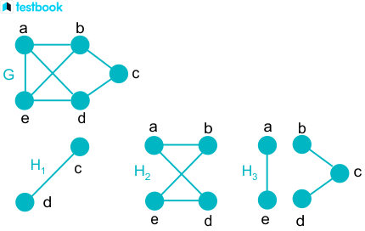
SUBGRAPHS
Graph is a structure amounting to a set of objects in which pairs of objects are in some way related.
A subgraph G of a graph is graph G’ whose vertex set and edge set subsets of the graph G. In simple words a graph is said to be a subgraph if it is a part of another graph.
Let’s consider V={v1,v2…..}
Edges E={e1,e2,e3…..}
Then the vertices in new graphs must be
i.e vi ⃀ V ,
AND ei ⃀ E.

Slide 11
04 CONCLUSION

Slide 12
CONCLUSION
In conclusion, isomorphism and subgraphs are foundational concepts in graph theory that are essential for understanding the relationships and structures within graphs. They provide valuable tools for analyzing, comparing, and classifying graphs, and are widely used in various fields, including computer science, mathematics, and network theory.
Isomorphism helps determine if two graphs are structurally identical, which is crucial for tasks like database management, network analysis, and pattern recognition. - Algorithms often exploit isomorphism to simplify complex graph problems by reducing them to simpler, known cases. Isomorphism is used in cryptography to detect structural similarities between graphs, aiding in the identification of potential security vulnerabilities.
Subgraphs are essential for identifying recurring patterns in networks, which is useful in fields like biology, sociology, and computer science. In essence, isomorphism and subgraphs are key concepts in graph theory that enable the analysis, comparison, and understanding of complex networks, making them indispensable in various real-world applications.

Slide 13
THANK YOU

